Slide 1
Knight BSR Reproducible Research Journal Club
August 3, 2016
Presenter: E. Latour

Slide 2
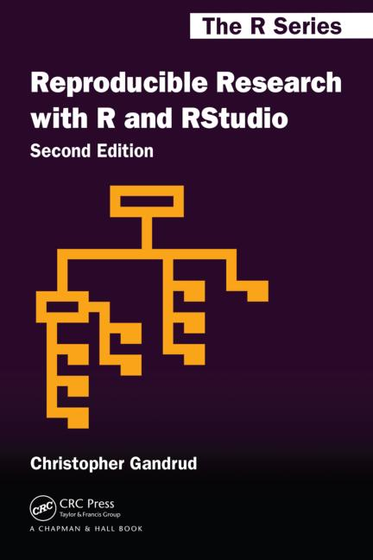
Readings covered
Reproducible Research with R and RStudio
By Christopher Gandrud
Chapter 1 – Introducing Reproducible Research
Chapter 2 – Getting Started with Reproducible Research

Slide 3
Chapter 1 Introducing Reproducible Research

Slide 4
Chapter 1 Preview
Introduction and motivation.
What is reproducible research?
Why should research be reproducible?
Tools advocated by the author.

Slide 5

“Advertising”
The presentation documents that announce findings and try to convince that they results are correct.
(Mesirov, 2010)

Slide 6
Research
“the full software environment,
code,
and data that produce the results”
(Buckheit and Donoho, 1995; Donoho, 2010, 385)

Slide 7
The Problem
Separating research and the advertising
make it difficult for others
to reproduce and verify the findings.

Slide 8
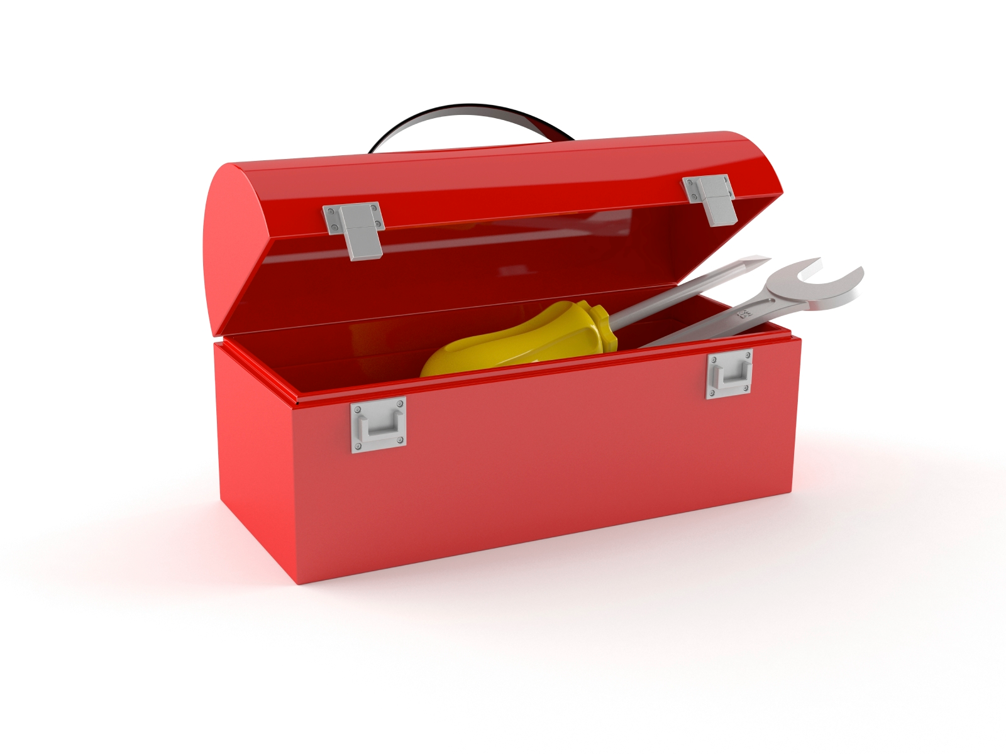
The Solution
Two tools

Slide 9
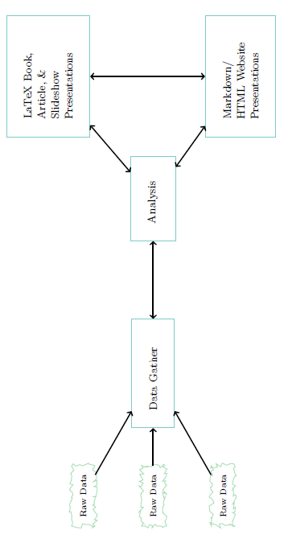
Workflow

Slide 10
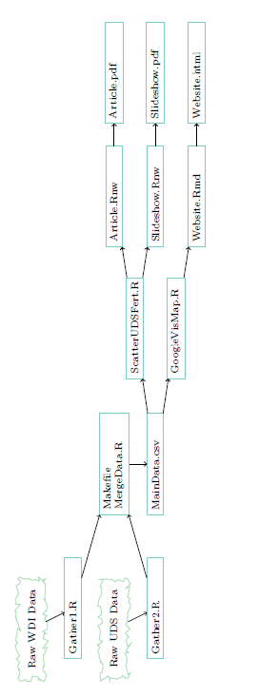
Workflow (2)

Slide 11
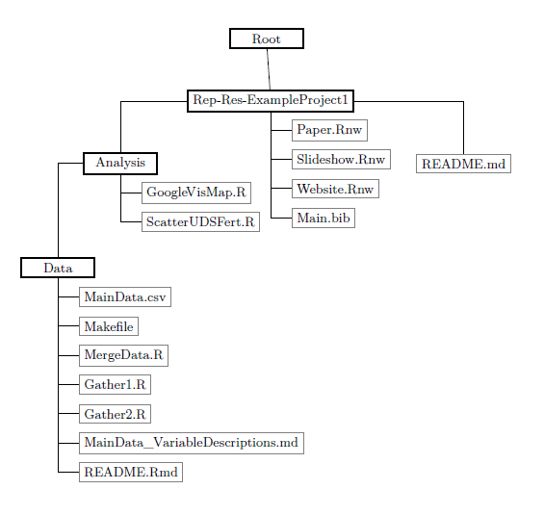
Workflow (3)

Slide 12

Computer Tools

Slide 13
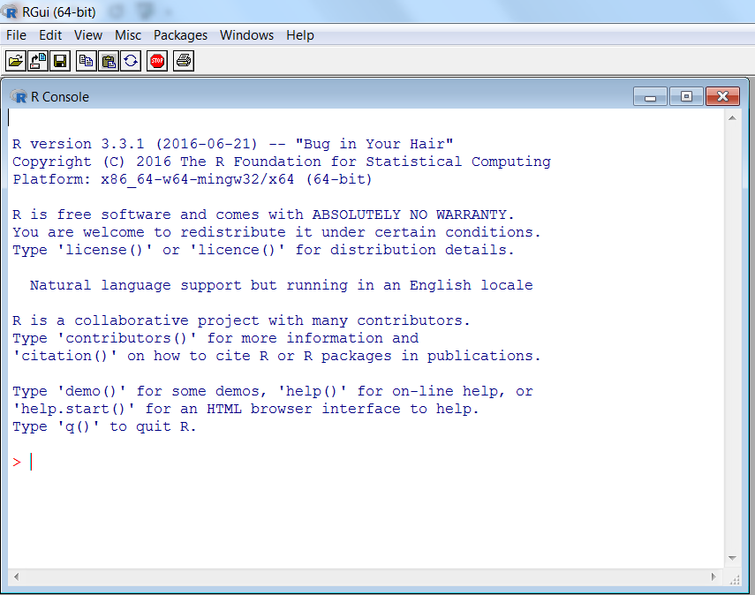

Computer Tools

Slide 14
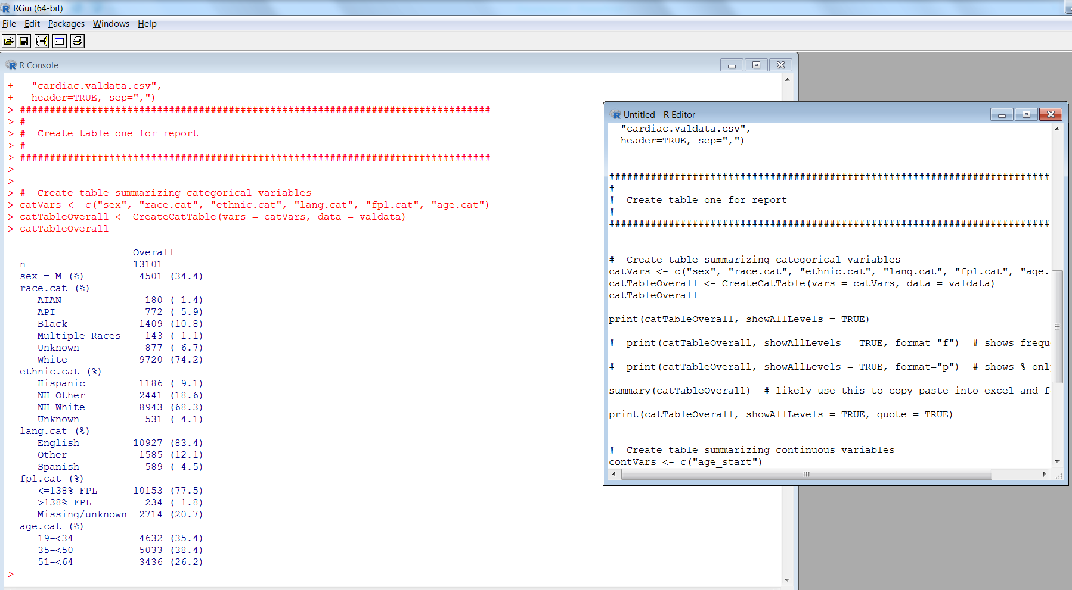

Computer Tools

Slide 15
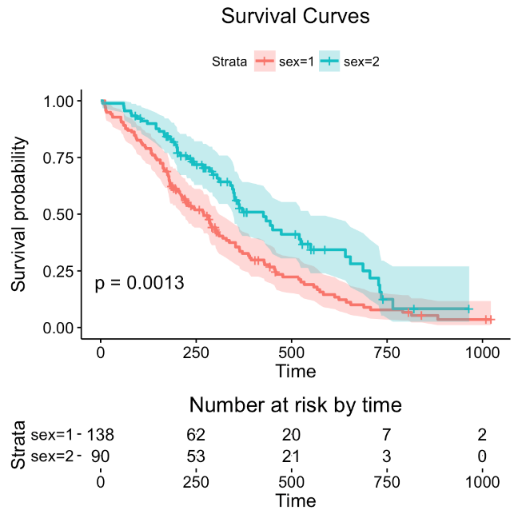
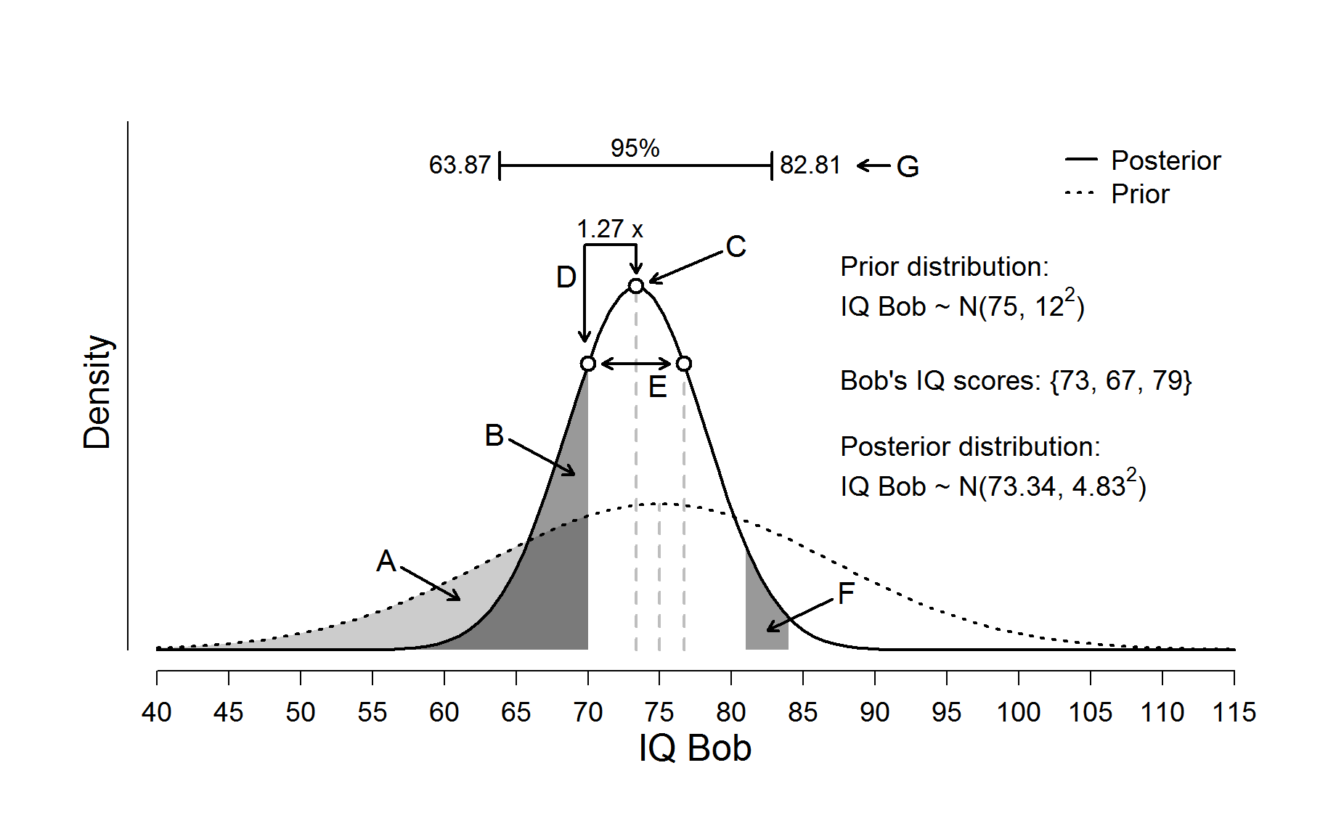
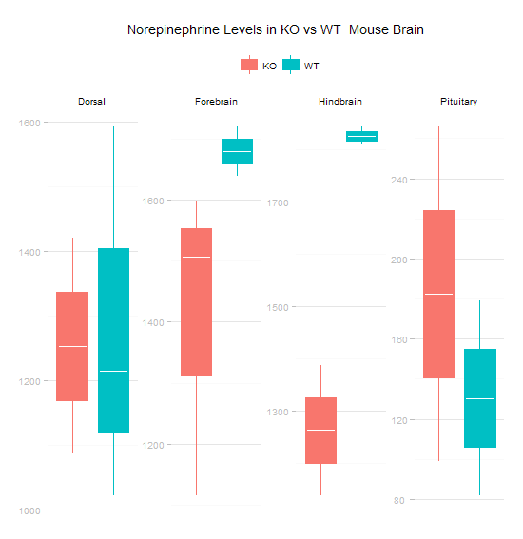
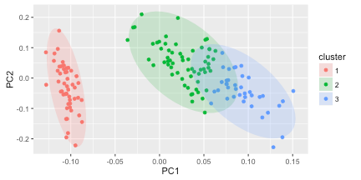

Computer Tools

Slide 16
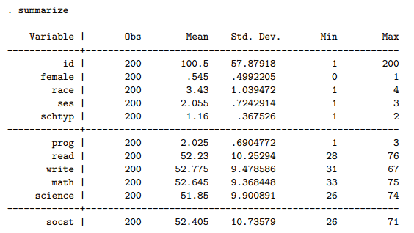
Computer Tools
For example, here’s some Stata code and output (not R)

Slide 17

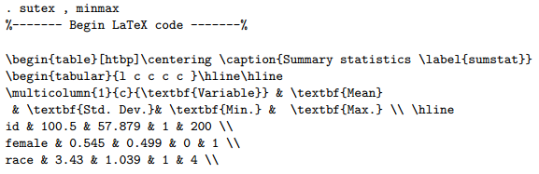
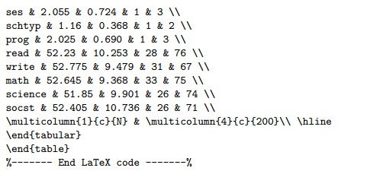
Computer Tools

Slide 18

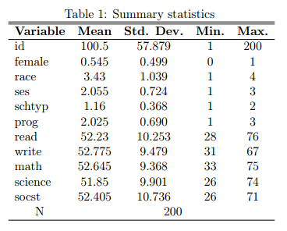
Computer Tools

Slide 19

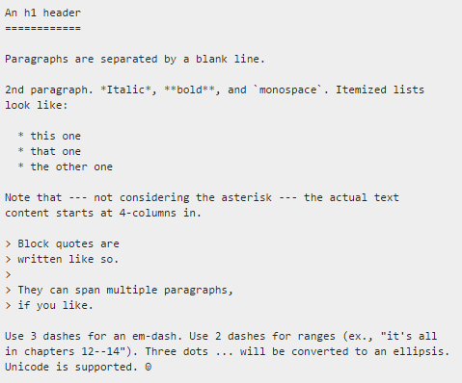
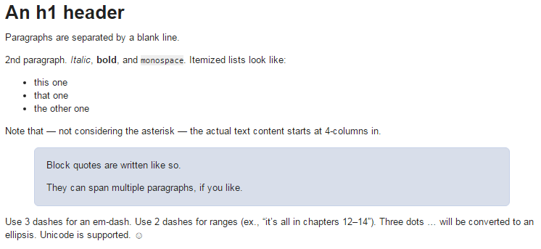
Computer Tools

Slide 20
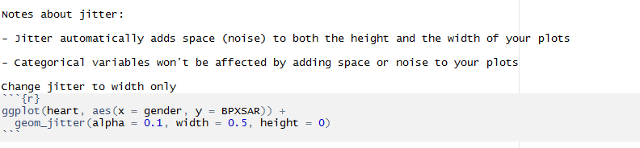
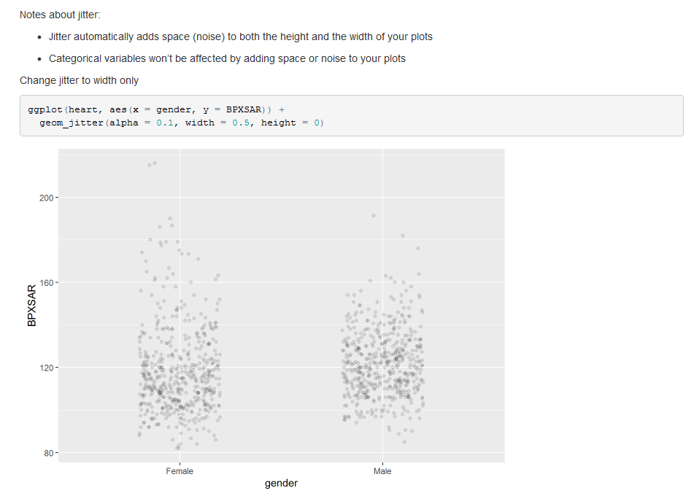
Computer Tools

Slide 21
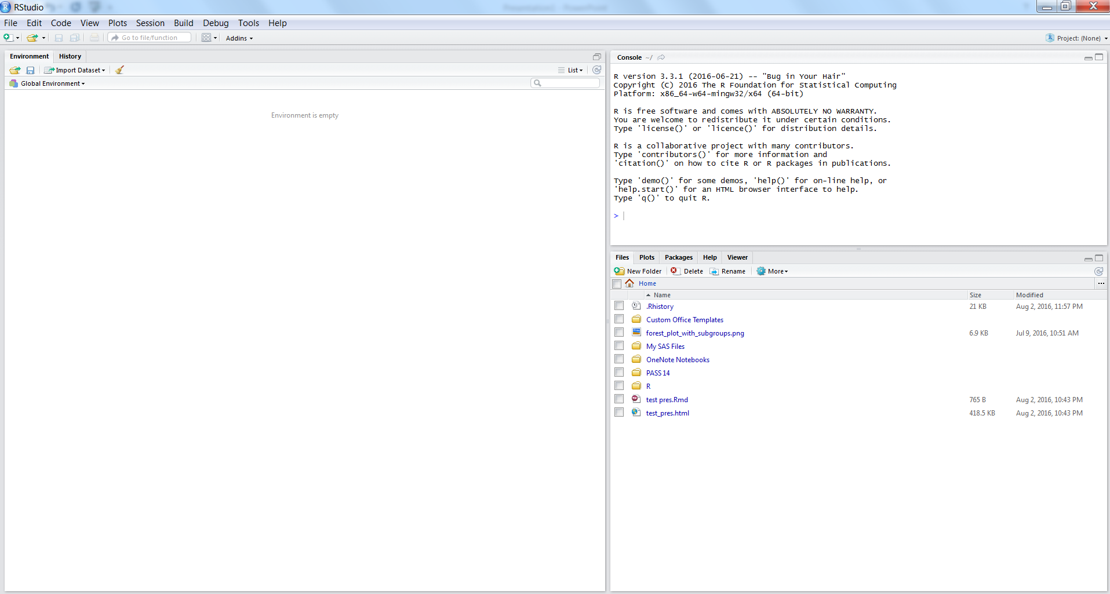
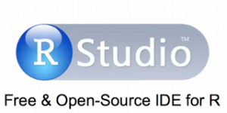
Computer Tools

Slide 22
Summary of the Book’s Goals
Make it easier for others to verify and reproduce findings.
By dynamically combining research with presentation
Tools of Reproducible Research
1. Workflow
2. Computer tools
R
LaTeX and Markdown
knitr and rmarkdown
RStudio

Slide 23
What is Reproducible Research?

Slide 24
Replicable
Not the same as reproducible
Highest Standard
Sufficient information for independent researchers to recreate findings by
Following original procedures to gather new data, and
Running the computer code.

Slide 25
Reproducible
Minimum standard
“Really reproducible research” (Peng, 2011, 1226)
The data and code used to make a finding are available and they are sufficient for an independent researcher to recreate the finding (Gandrud p. 4)

Slide 26
Reproducible
Keys to reproducible research:
Data
Code
Sufficient to recreate independently.
Bonus: in practice, this needs to be easy

Slide 27
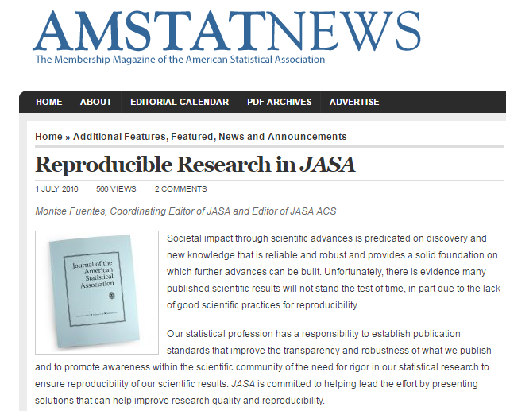
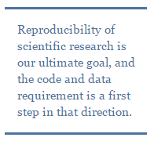
Reproducible Research in the News
http://magazine.amstat.org/blog/2016/07/01/jasa-reproducible16/

Slide 28
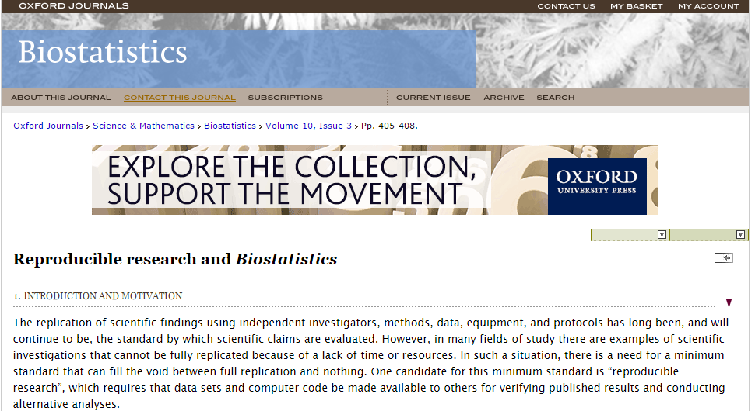
Reproducible Research in the News
http://biostatistics.oxfordjournals.org/content/10/3/405.full

Slide 29
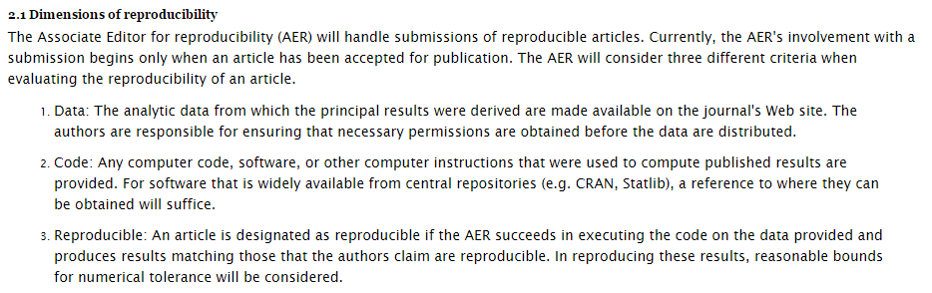
Reproducible Research in the News
http://biostatistics.oxfordjournals.org/content/10/3/405.full

Slide 30
Why Should Research Be Reproducible?

Slide 31
Replicability is a key part of scientific inquiry and is what distinguishes science from non-science.
(Braude, 1979, 2)

Slide 32
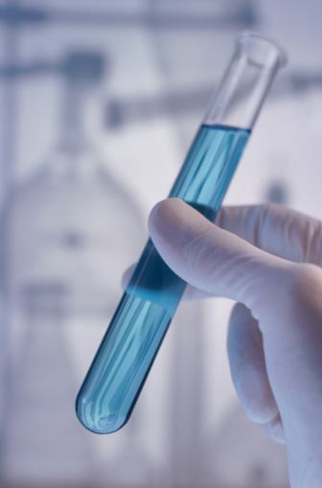
For Science
Standard to judge scientific claims
Replication – the ultimate standard
Reproduction – the minimum standard
“a study can be reproducible and still be wrong.” (Peng, 2014)
Avoiding effort duplication
cumulative knowledge development

Slide 33

For You
Better work habits
Better teamwork
Changes are easier
Higher research impact

Slide 34
Tools of Reproducible Research

Slide 35
Reproducible Research Environment
R – programming language for statistics and visualization.
RStudio – integrated developer environment (IDE) for R that combines R, knitr, rmarkdown, and markup languages.
Cloud storage and versioning – Drobox or Git/GitHub can store data, code, and presentation files; and make this widely available.

Slide 36
Reproducible Research Publisher
knitr and rmarkdown – R packages for literate programming. Allow you to combine statistical analysis with presentation of results in one place.
Markup languages – formatting syntax; instructions for how to format a document for presentation. The text covers LaTex, Markdown, and some HTML.

Slide 37
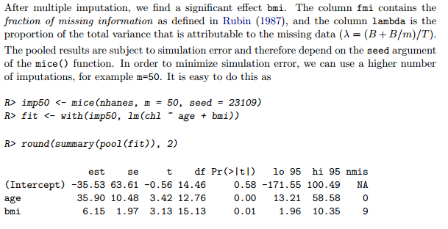
Literate programming
Idea introduced by Donald Knuth in 1983.
Readable for humans not computers.
Explains program language in natural language.
Documentation with code inserted rather than code with comments.

Slide 38
For More About the Tools
Gandrud, pages 11–13 for reasons for these tools.
Chapter 1 for more about getting the tools and some more intro.
See end of Chapter 1 for recommended readings.
Google searches.
Play with the tools yourself.

Slide 39
Chapter 1 Summary Points
What is reproducible research?
“The data and code used to make a finding are available and they are sufficient for an independent researcher to recreate the finding.”
Why should research be reproducible?
For science.
For you.
Tools for reproducible research.
Reproducible research environment – R, RStudio, Cloud Storage and Versioning.
Reproducible research publisher – knitr, rmarkdown, and Markup Languages.

Slide 40
Chapter 2 Getting Started with Reproducible Research

Slide 41
…reproducibility is not an afterthought—it is something that must be built into the project from the beginning.
(Donoho, 2010, 386)

Slide 42
Chapter 2 Preview
Big picture workflow.
Practical tips.

Slide 43
Big Picture of the Workflow for Reproducible Research

Slide 44
Big Picture
Data gathering,
Data analysis, and
Results presentation.

Slide 45
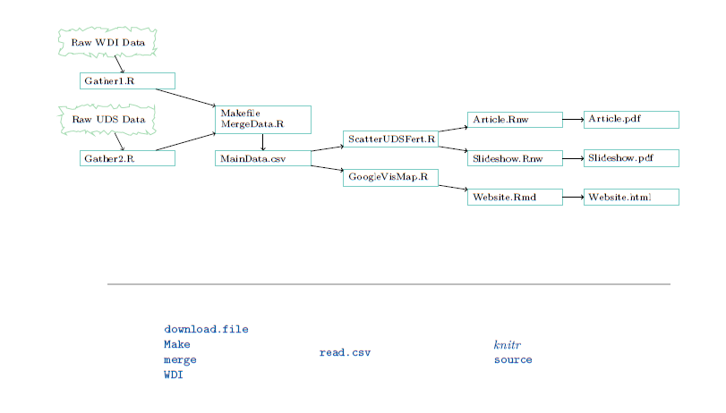
Workflow

Slide 46
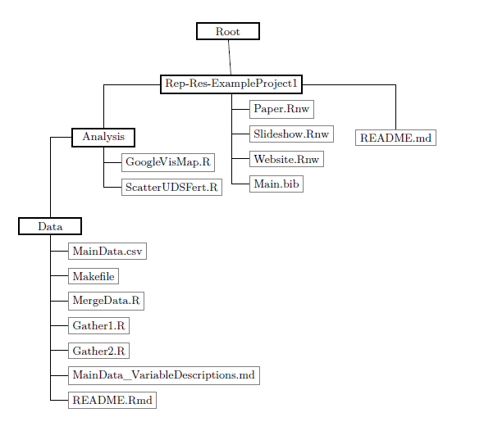
Workflow

Slide 47
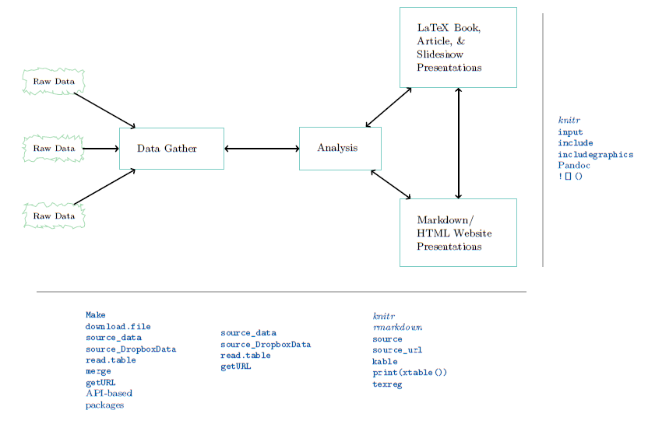
Workflow

Slide 48
Practical Tips for Reproducible Research

Slide 49
Document everything!
Tell your reader how you gathered your data, analyzed it, and presented the results.
Document your R session info – functionality can differ from version to version. Also, possible in SAS or Stata or others with software updates.

Slide 50
Everything is a (text) file
The author advocates storing data, analysis, code, write-ups, explanations, etc. in the simplest file format possible – the text file.
Other researchers will always be able to open and view your research.
Comma-separated values (.csv) format, .R files, LaTeX (.tex), and Markdown (.md) files can all be opened by any program that can read text files
Future proof.

Slide 51
All files should be human readable
Comment your code with the goal of communicating its design and purpose.

Slide 52
Comment Frequently
Comment before a block of code to describe what it does.
Comment on any line of code that is unclear or open to interpretation.
In R, the hash mark (#) symbol indicates a comment.

Slide 53
Comment Frequently
An example:
# An entire comment line
2 + 2 # An inline comment after R code
[1] 4

Slide 54
Comment File Headers
Comment headers should at least include:
description of what the file does,
the date that it was last updated, and
the name of the file’s creator.

Slide 55
Comment File Headers
An example:
####################################################
# R source code file used to provide an example of
# comments and headers in R.
#
# Created by Emile Latour
# Last updated on 8-3-2016
####################################################

Slide 56
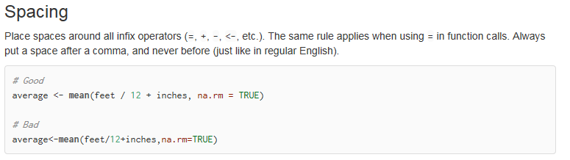
Style Guide
Easier to follow when consistent style and format are followed.
For example…

Slide 57
Style Guide
Google’s R Style Guide
https://google.github.io/styleguide/Rguide.xml
Hadley Wickham’s Style Guide (he’s the Chief Scientist at RStudio)
http://adv-r.had.co.nz/Style.html

Slide 58
Literate Programming
For important pieces of code, it can be useful to go beyond comments in the source file.
Display code in presentation text or in an appendix.
Think “discussion with code.”

Slide 59
Explicitly Tie Your Files Together
Make the links between your files explicit.
If everything is just a text file, the project is comprised of individual text files with relationships to each other.
Tie commands are most dynamic way to link files. See Gandrud page 28.

Slide 60
Have a plan to organize, store, and make your files available
Need to be organized.
Limit the amount of content in any one file.
Cloud services (Dropbox and GitHub) help organize and make files available.

Slide 61
Chapter 2 Summary Points
Big picture workflow
Be organized and planning at all stages of the work.
Practical tips.

